Slide 1

HYD
ROPOD : Revolutionizing Home Agriculture

Slide 2
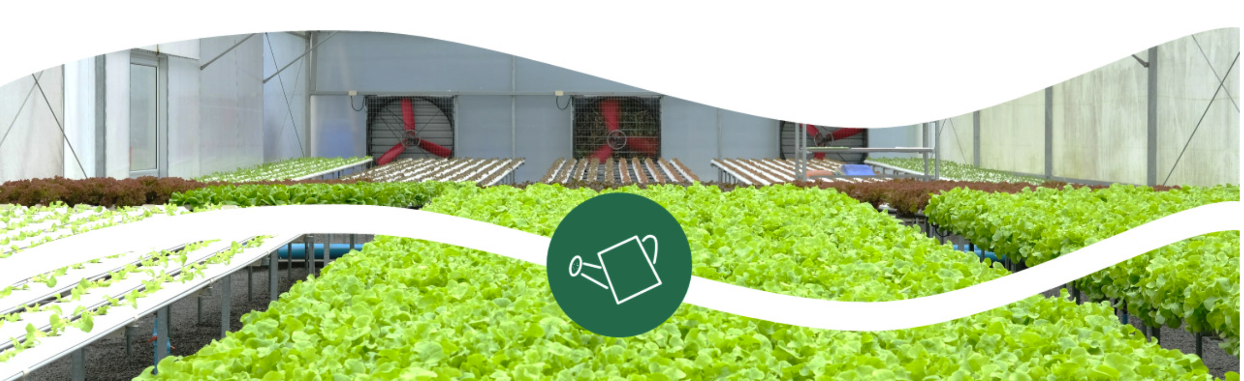
Mission & Vision
Welcome to HydroPod, where we're not just growing plants, we're cultivating a future of sustainable, accessible, and personalized agriculture.
Vision -"Empowering every home with sustainable, smart, and efficient agriculture—reshaping the future of home farming, one pod at a time.”
Mission - "To revolutionize home agriculture by providing innovative, affordable, and technology-driven hydroponic solutions that enable individuals to grow fresh, nutritious produce effortlessly while promoting sustainability and self-sufficiency."

Slide 3

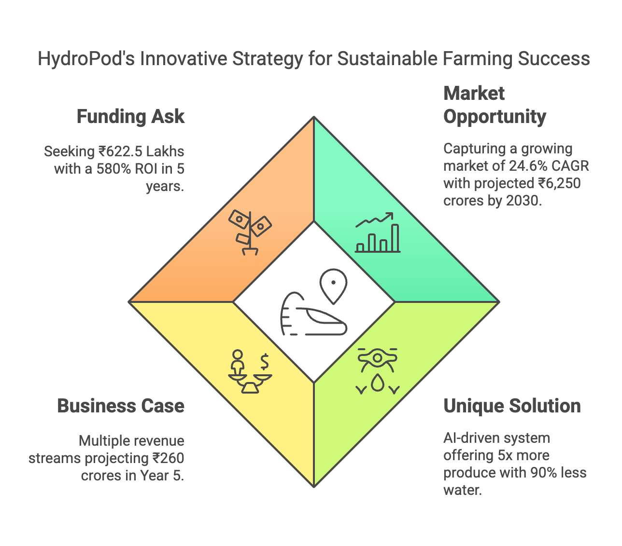
Executive Summary
HydroPod is strategically positioned at the intersection of several high-growth markets. These include smart home technology, sustainable living products, food tech and agtech, and subscription commerce. This convergence creates a unique opportunity for HydroPod to capture significant market share.

Slide 4

Pain Points & Solutions
Pain Point | Market Reality | HydroPod Solution | Customer Benefit
Limited Growing Space | 68% of global population will live in urban areas by 2050 | Vertical, modular design with minimal footprint (12"x12" base) | Grow up to 36 plants in the space of a small side table
Time Constraints | 76% of homeowners want to grow food but cite time as the biggest barrier | AI-controlled lighting, watering, and nutrient delivery system | 95% reduction in time spent on plant maintenance
Lack of Expertise | 82% of first-time gardeners fail within the first season | App-based system with notifications and guidance | Real-time insights eliminate guesswork for beginners
Water Conservation | Traditional gardening uses 2x more water than necessary | Closed-loop recirculation system | 90% less water than soil gardening
Year-Round Production | Seasonal limitations prevent consistent harvests | Controlled environment independent of weather | Continuous harvest cycles regardless of season
Rising Food Costs | Fresh produce prices increased 13.2% in 2023 | Efficient growing system with subscription model | ₹282 average cost per pound (60% savings vs. store-bought organic)

Slide 5
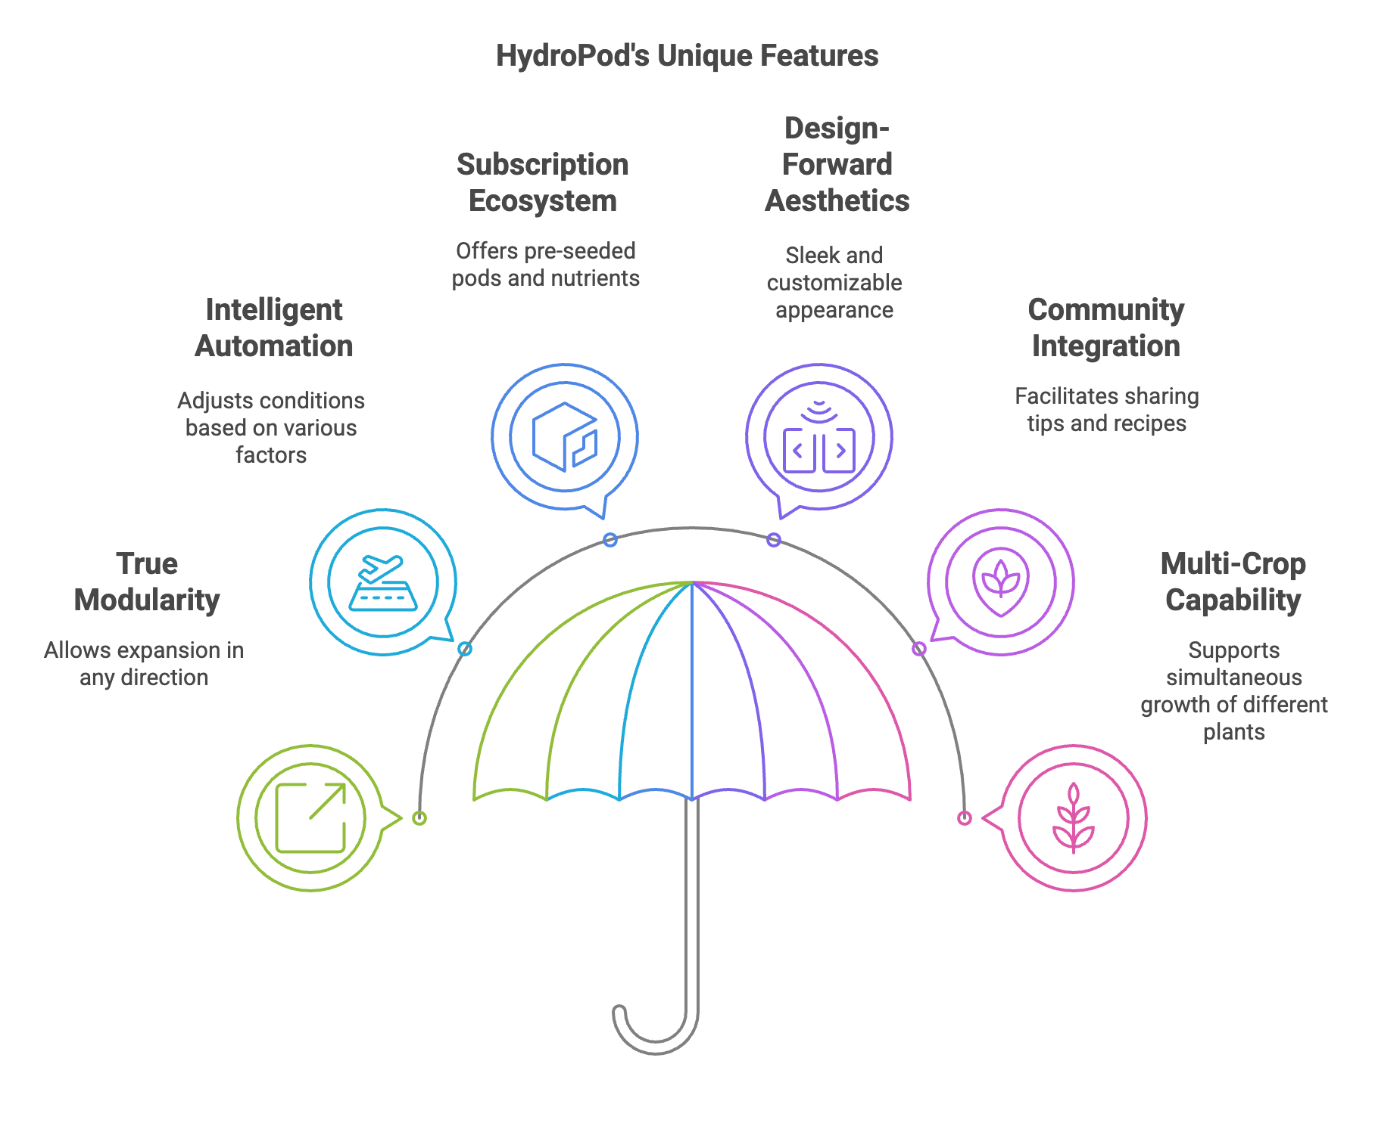
Unique Selling Proposition – HydroPod Unique Features

Slide 6






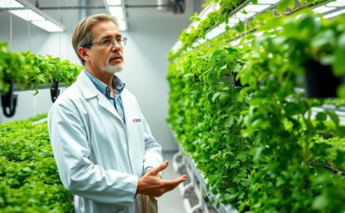

Key Competencies Required
Our team blends entrepreneurial drive with strategic hiring, focusing on expertise in technical and business leadership, enhanced by a strong advisory network.
THYDROPONICS SPECIALIST
SOFTWARE DEVELOPER
HARDWARE ENGINEER
OPERATIONS MANAGER
Hydroponics specialist for nutrient formulation and system optimization.
IoT/software developer for sensor integration and mobile app development.
Hardware engineer for modular systems and water circulation design.
Operations manager experienced in consumer hardware manufacturing.
MARKETING STRATEGIST
SUPPLY CHAIN EXPERT
AGRICULTURAL SCIENTIST
RETAI;/DISTRIBUTION SPECIALIST
Marketing strategist for subscription products and D2C strategies.
Supply chain expert for component sourcing
in India.
Agricultural scientist specializing in
hydroponic growing.
Retail/distribution specialist for premium
brand positioning.
Advisory Network

Slide 7





Target Customer Segments
HydroPod appeals to diverse customers. Here's a breakdown of key segments:
Urban Innovators
Health-Conscious Families
Tech Enthusiasts
Culinary Hobbyists
Tech-savvy early adopters focused on sustainability.
25-40 years old
₹75K+ income
Primarily female.
Metro apartments in Mumbai, Delhi, and Bangalore.
Gadget collectors who are data-driven and focused on automation.
22-50 years old
₹85K+ income
Largely male
Tech hubs in Bangalore, Hyderabad, and Pune.
Cooking enthusiasts passionate about ingredient quality and sharing their creations.
35-65 years old,
Diverse incomes
Primarily female.
Found nationwide, concentrated in food-culture cities.
Nutrition-minded, with an organic preference and educational focus.
30-45 years old
₹90K+ household income Suburban homes in Tier 1 & 2 cities.
Initially focused on the Indian market, HydroPod plans to expand to global markets in Phase 2 (Years 3-5).

Slide 8
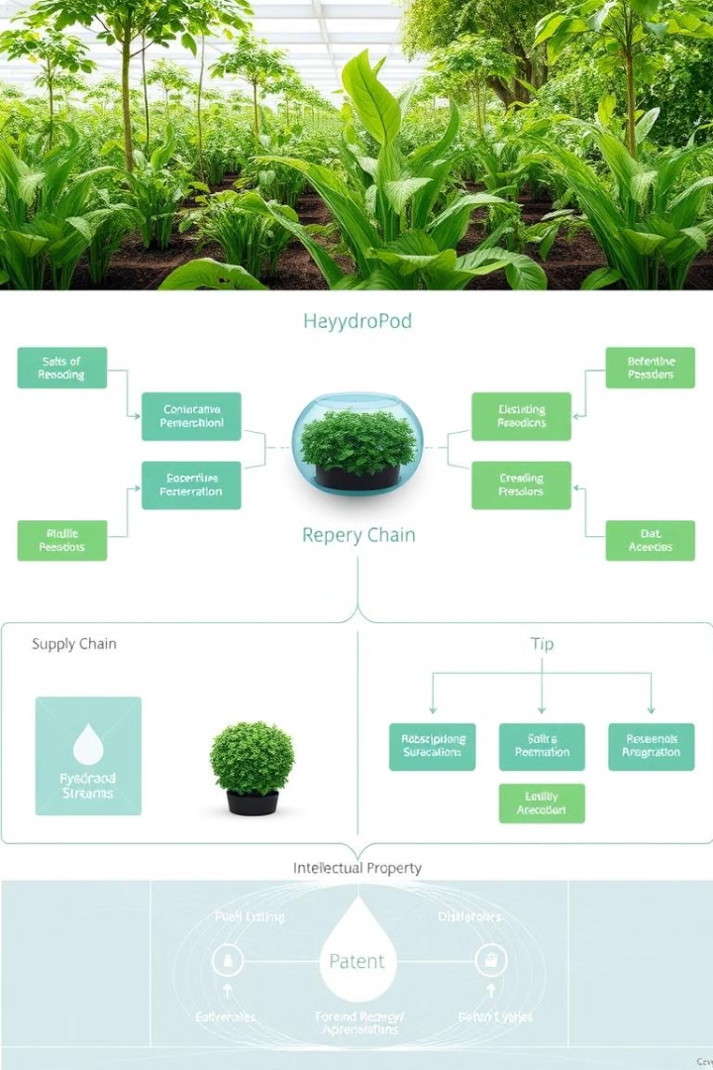
Business Architecture
Revenue Model
Supply Chain Strategy
Hardware sales, consumables subscription, and B2B solutions generate revenue.
Component sourcing, assembly, distribution, and after-sales support ensure efficient operations.
Intellectual Property
Patent application, proprietary algorithms, and registered design protect HydroPod's innovations.

Slide 9








Business Model: Cultivating Revenue
Kit Sales
Subscription
Direct sales of HydroPod kits through our website and retail partnerships.
Recurring revenue from nutrient refills and system upgrades.
App
Service
Premium features via in-app purchases.
Installation and maintenance packages for a premium experience.
Our revenue model is based on a combination of direct sales, subscription services, and premium support offerings. Our pricing strategy is competitive, with tiered options to cater to a wide range of customers. Our scaling plans include expanding our product line, establishing strategic partnerships with retailers, and entering new geographic markets.

Slide 10


HYD
ROPOD : PRODUCT SEGMENT 1 of 2
HYDROPOD BASIC
HYDROPOD PLUS
HYDROPOD PRO
Product Details
Pricing
Place & distribution
Promotion
Pace
Product Delivery
Customer Exp.
12 plants, compact (12"x12"), smart lighting & water system
₹24,817 (48% margin)
E-commerce (Amazon, Flipkart), urban retail
Social media tutorials, entry-level incentives
Q4 2025 launch, metro cities first
Eco-friendly packaging, 3-5 day delivery
Basic onboarding, standard support
18 plants, larger (15"x15"), enhanced lighting & water monitoring
₹33,117 (51% margin)
Premium home stores, specialty garden centers, real estate partners
Family health campaigns, influencer partnerships
Tier 1 & 2 cities, quarterly feature updates
Premium unboxing, scheduled delivery
Priority phone support, recipe sharing
24 plants, premium build, advanced analytics
₹41,417 (53% margin)
High-end retail, restaurants, culinary academies
Chef partnerships, gourmet content, exclusive events
Premium launch, limited availability, early access
White-glove delivery, pro installation, custom setup
Concierge setup, gourmet guides, dedicated support

Slide 11



HYD
ROPOD : PRODUCT SEGMENT 2 of 2
SEED POD SUBSCRIPTION
PREMIUM APP FEATURES
EXPANSION MODULES
Product Details
Pricing
Place & distribution
Promotion
Pace
Product Delivery
Customer Exp.
6-12 extra plants, stackable design, universal fit
₹10,707-16,517 (56% margin)
Online cross-sell, targeted email, seasonal promos
Upgrade incentives, "Grow More" campaigns, success showcases
Available 90 days post-purchase, seasonal editions
Quick-connect add-ons, expansion tutorials
System optimization, harvest maximization
Monthly curated seeds, nutrients, recipe cards
₹2,489/month (72% margin)
Direct subscription, auto-delivery, gifting options
Cuisine-based marketing, referral rewards, seasonal specials
Monthly delivery, seasonal variety rotation
Letterbox-friendly, eco-packaging, carbon-neutral shipping
Personalized selection, growth notifications,
Growing recipes, expert consultation, data insights
₹829/month (85% margin)
In-app purchases, subscription bundles, free trials
In-app upsells, exclusive previews, community challenges
Bi-weekly updates, special event content
Instant digital access, automatic updates
AI growing assistance, expert chat, achievement system

Slide 12

Competitive Landscape – India & Global
Competitor | Location | Price Point | Key Features | Major Limitations | HydroPod Advantage
UrbanKisaan | India | ₹4,500-12,000 | • Indian company • Local presence | • No smart features • Limited scalability | AI automation Modular design 5x greater yield
Hydrilla | India | ₹2,000-8,000 | • DIY focus • Affordable | • Technical setup • High maintenance | Plug-and-play simplicity 90% less maintenance
BitMantis | India | ₹15,000-30,000 | • Smart elements • Some automation | • Institutional focus • Bulky design | Home-friendly design Consumer-first approach
AeroGarden | Global | ₹8,300-33,200 | • Established brand • Wide range | • Expensive pods • No India focus | India-optimized Better value Local support
Click & Grow | Global | ₹16,600-24,900 | • Simple design • Retail presence | • Fixed size • Limited adaptation | Expandable system Better suited for Indian cooking
Gardyn | Global | ₹70,550 | • AI-driven • Vertical design | • Extremely high price • No India presence | 60% more affordable Local market knowledge

Slide 13


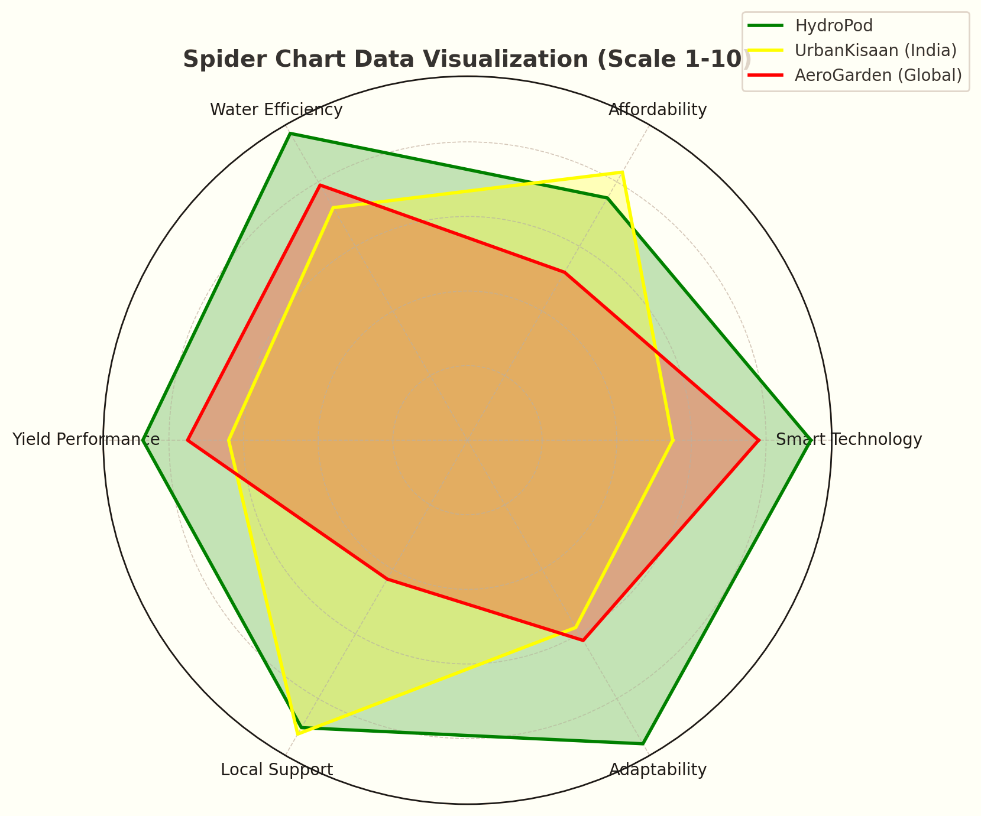

Competitive Advantages
1
Affordable
Priced for Indian urban households while offering global-standard technology
2
Scalable
Only truly expandable system for space-constrained Indian apartments
3
Sustainable
90% water reduction - critical in water-scarce Indian cities
4
Universal
Optimized for both Indian vegetables and global varieties
5
Rapid
30% faster growth cycles than competitors
6
Excellent
Premium user experience with multilingual support
7
Distinctive
First AI-driven hydroponics system designed with Indian needs in mind

Slide 14






Key Communication Channels
Website & Blog
Primary information hub with SEO-optimized content and direct sales.
Social Media
Brand awareness and community building through platform-specific content.
Email Marketing
Lead nurturing and customer retention with personalized recommendations.
PR & Media
Credibility building through sustainability and food security narratives.
Trade Shows
Building B2B relationships by product demonstration and industry networking
HydroPod utilizes multiple communication channels to reach its target audience. These include a website and blog, social media, email marketing, and PR & media. Each channel serves a specific purpose in building brand awareness, nurturing leads, and retaining customers.

Slide 15

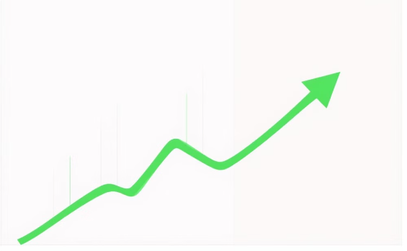
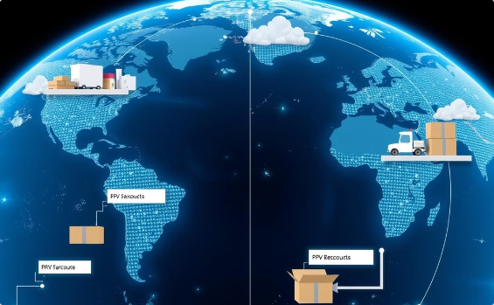
Procurement, Funding & Distribution Channels
Procurement
Funding
Distribution
Strategic partnerships ensure high-quality components and materials.
Diverse funding sources support growth and expansion.
Multi-channel distribution strategy for market penetration.
Electronics: Foxconn, Jabil
Seed: Angel investors (₹622.5 Lakhs)
Phase 1: Direct e-commerce and online marketplace
Plastics: Nypro, Flex
Series A: Venture capital (₹2,905 Lakhs)
Packaging: Ecologic Brands
Series B: Institutional investors
(₹8,300 Lakhs)
Phase 2: Premium retail partnerships (Urban Ladder, Croma)
Seed Pods: In-house production with agricultural suppliers
Phase 3: National retail chains and international expansion
B2B: Educational institutions and restaurants (Year 3+)

Slide 16
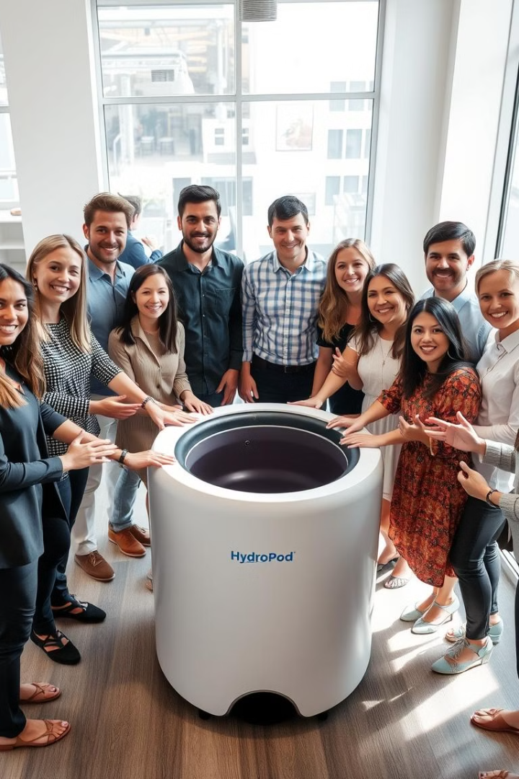


Emotional Connect
Customers
Pride in growing own food + personalized growing journey
Employees
"Growing more than plants –
we're cultivating a sustainable
community"
Mission-driven culture with equity ownership
Suppliers
Long-term partnerships with transparent forecasting
Brand Promise
Investors
Clear milestone reporting and strategic engagement
"Loyalty with Royalty" Programs
1
HydroPod Champions
2
Harvest Credit System
Early access, influence on roadmap
Rewards for growing success
3
Community Impact
Food security initiatives with customer direction

Slide 17
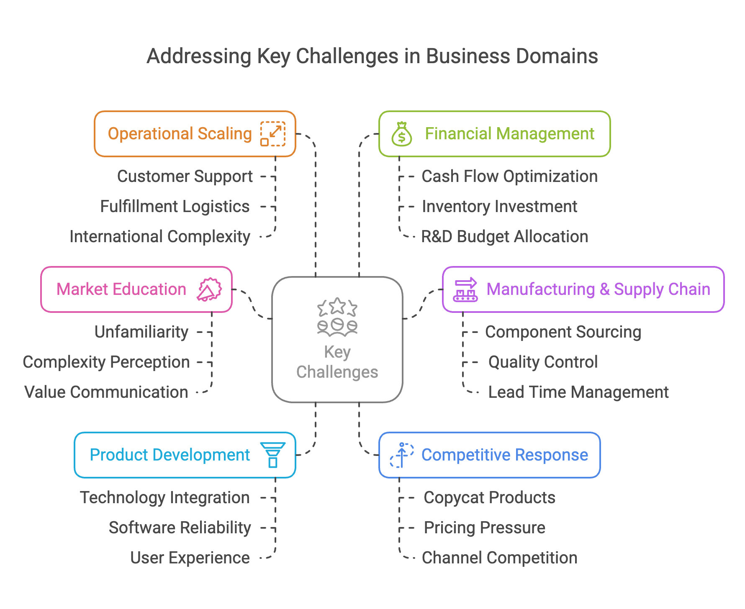
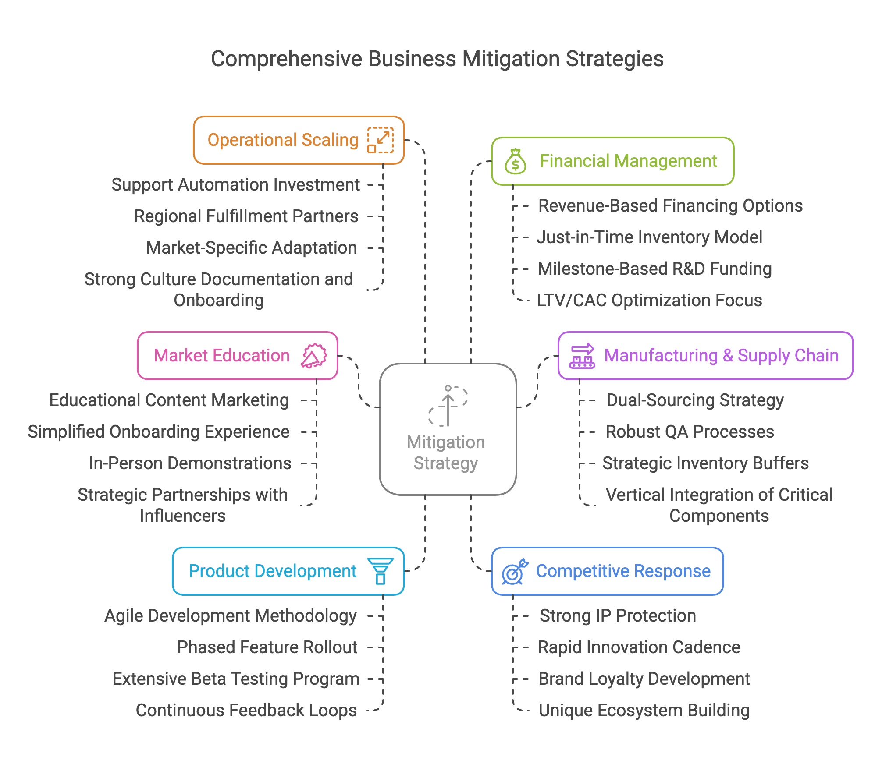
Key Challenges
CHALLENGES
MITIGATION STRATEGIES

Slide 18
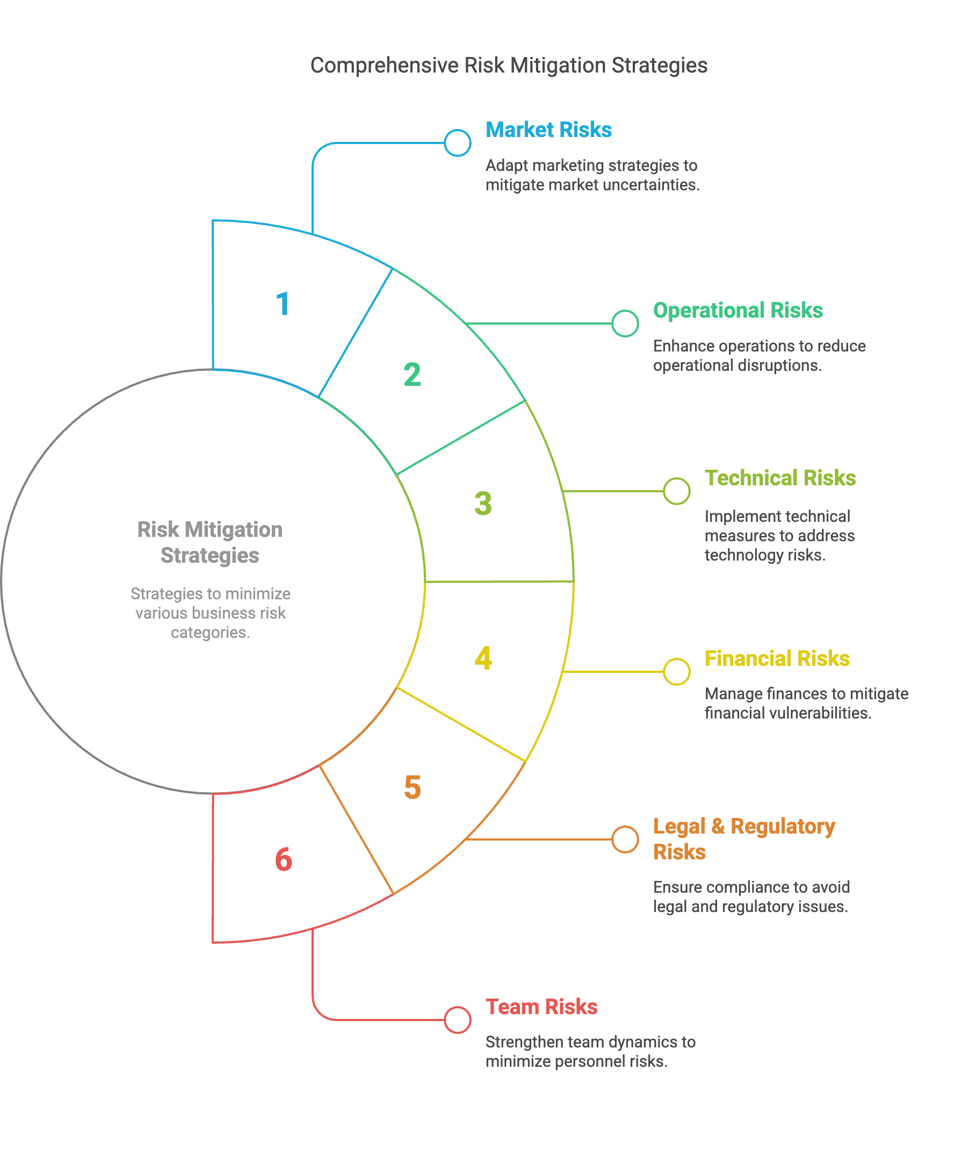
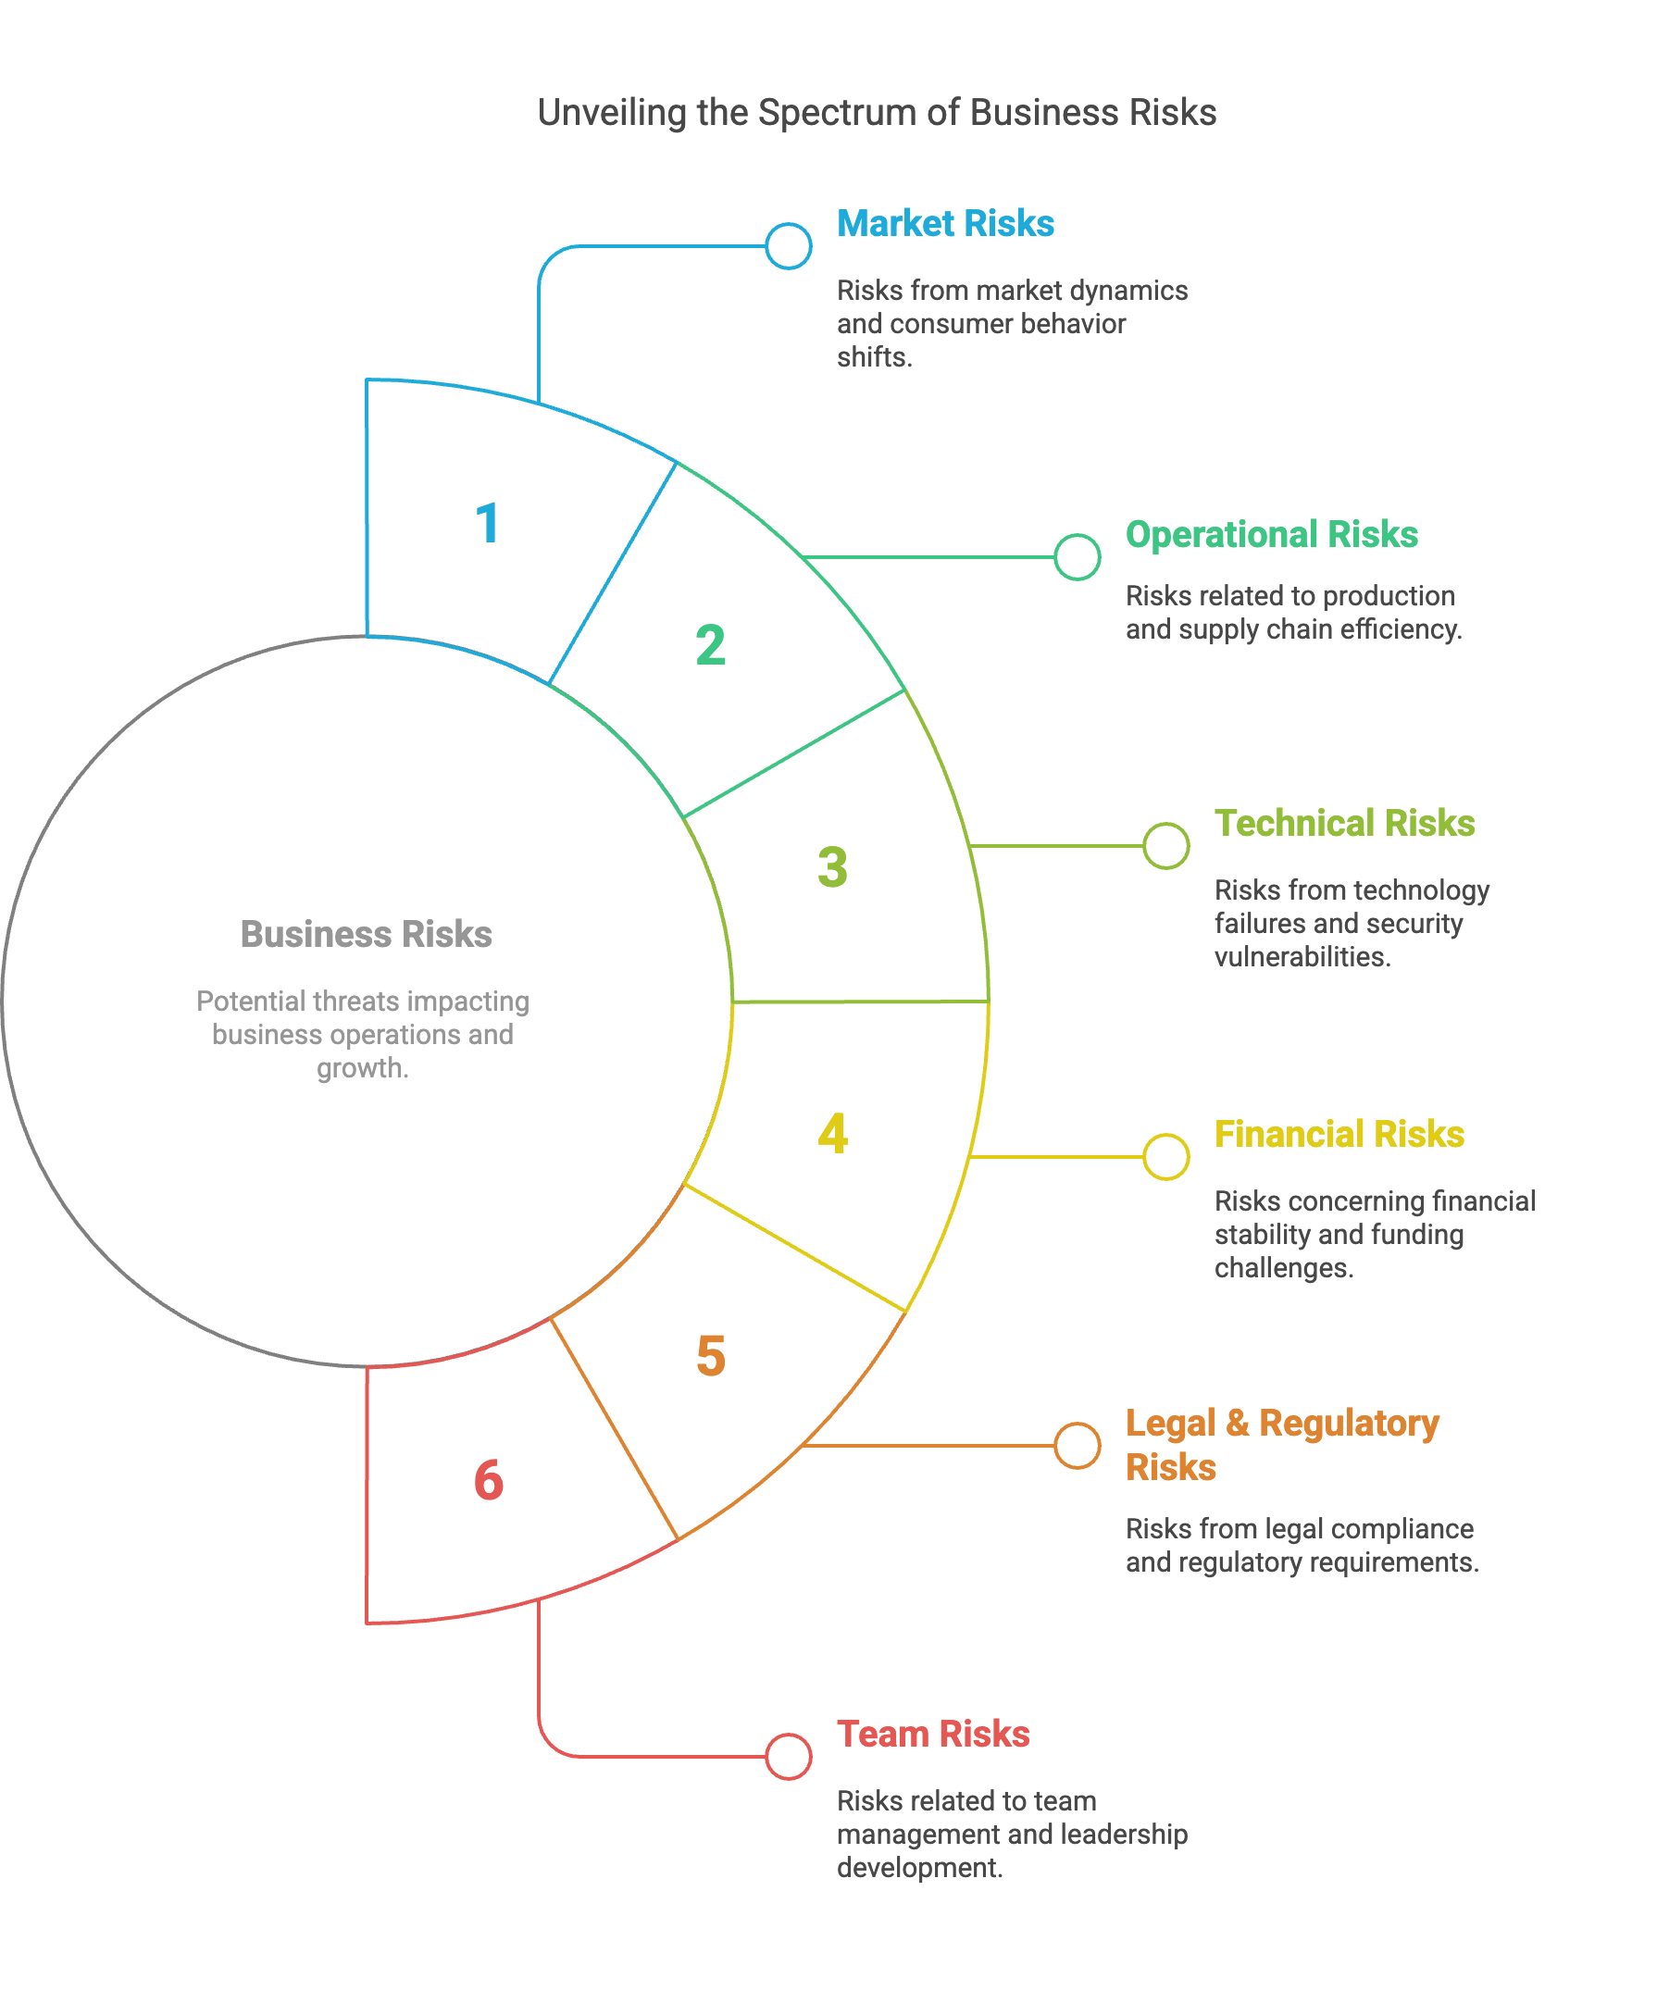
Key Risks
RISKS
MITIGATION STRATEGIES

Slide 19
Key Partners
TECHNOLOGY
DISTRIBUTION
CONTENT & EDUCATION
SUSTAINABILITY
Collaborate with IoT, AI, and app developers for seamless integration and co-development.
MANUFACTURING
Leverage e-commerce, retail, and logistics partners for market reach and brand visibility.
Engage influencers, educators, and media for credibility, awareness, and knowledge sharing.
RESEARCH
Align with environmental groups and nonprofits for ESG goals and community impact.
Work with suppliers and manufacturers to ensure quality, scalability, and cost efficiency.
Partner with universities and R&D institutions to drive innovation and validation.
Partnership Approach:
Shared success metrics
Strategic communication
Recognition programs
Innovation collaboration
Long-term commitment

Slide 20
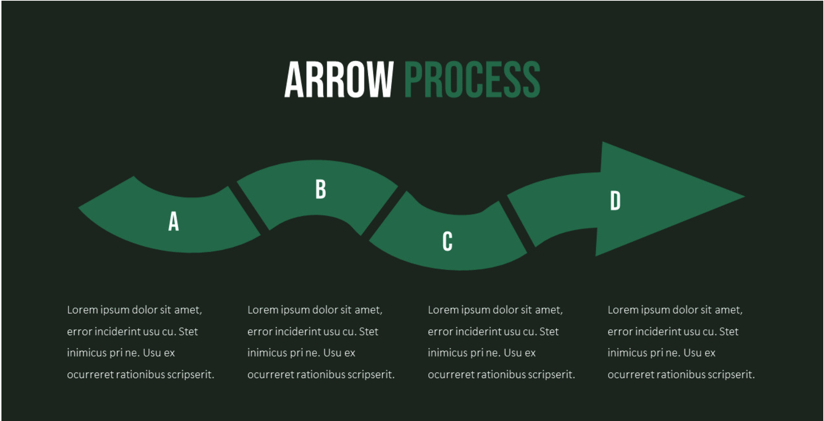
KEY RESOURCES
Financial Resources
Human Resources
Physical Resources
Technological Resources
Hydroponic growth chambers
Water reservoirs & nutrient systems
Manufacturing & assembly facilities
Warehousing & logistics network
Seed Capital & Investments
Grants & Subsidies
Revenue Sources:
Hydropod unit sales
Subscription services
Technical support & consultation
R&D Team: Engineers, agronomists, product designers
Operations: Manufacturing, supply chain, quality control
Sales & Marketing: Business development, digital marketing
Technical Support: Customer training & troubleshooting
IoT & Automation: Smart sensors, AI analytics
Cloud & Software: Real-time monitoring, remote diagnostics
CRM & Sales Platforms: Customer engagement & online sales

Slide 21

Key Activities
Activity Area | Critical Tasks | Resources Required | Success Metrics
Product Development | Hardware & software engineering, User testing | R&D team, Testing facilities | Time to market, User satisfaction
Manufacturing & Supply Chain | Component sourcing, Quality control | Manufacturing partners, QA systems | Unit cost targets, Lead times
Marketing & Brand Building | Content creation, Digital marketing | Marketing team, Analytics tools | Brand awareness, Conversion rates
Sales & Distribution | E-commerce, Channel management | Sales team, CRM platform | Revenue targets, Average order value
Customer Support & Success | Onboarding, Technical support | Support team, Knowledge base | Response time, Customer retention
Research & Innovation | New product research, Patent development | R&D team, University partnerships | Innovation pipeline, New launches

Slide 22
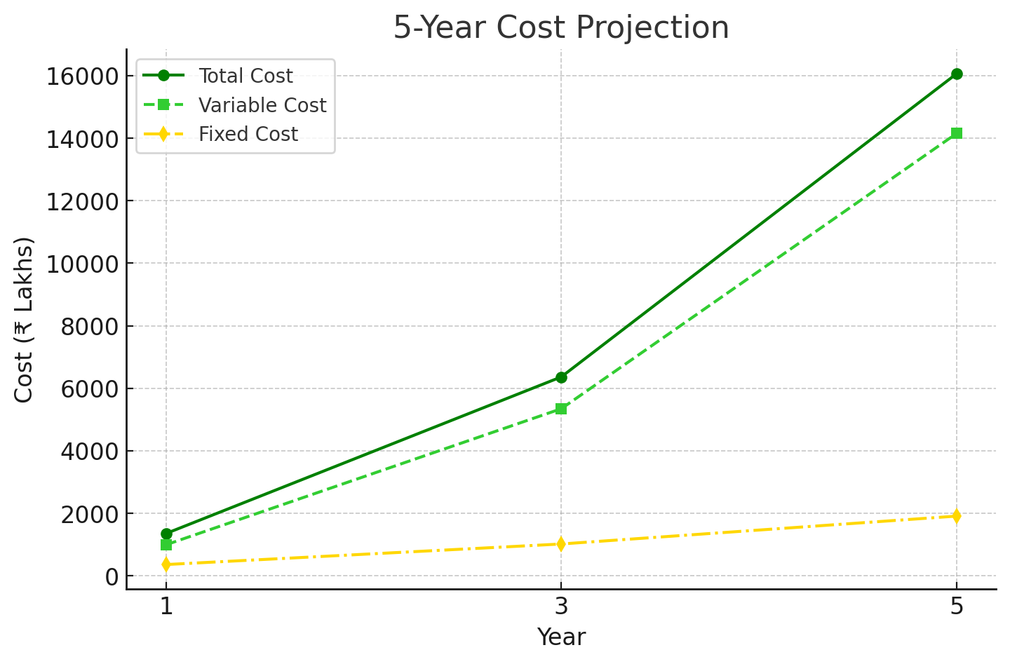
Cost Structure
Cost Category | Year 1 | Year 2 | Year 3 | Year 4 | Year 5
Fixed Costs
R&D | 72.0 | 136.0 | 196.0 | 280.0 | 350.0
Salaries & Benefits | 168.0 | 310.0 | 520.0 | 780.0 | 1,020.0
Facilities & Equipment | 42.0 | 72.0 | 120.0 | 170.0 | 220.0
Software & Technology | 36.0 | 58.0 | 84.0 | 120.0 | 160.0
Professional Services | 42.0 | 64.0 | 98.0 | 130.0 | 160.0
Fixed Costs Subtotal | 360.0 | 640.0 | 1,018.0 | 1,480.0 | 1,910.0
Variable Costs
COGS - Hardware | 489.7 | 1,452.5 | 2,697.5 | 4,648.0 | 7,387.0
COGS - Subscription | 91.3 | 323.7 | 647.4 | 1,203.5 | 1,992.0
Fulfillment & Shipping | 99.6 | 315.4 | 605.9 | 1,037.5 | 1,701.5
Customer Acquisition | 232.4 | 614.2 | 1,079.0 | 1,535.5 | 2,199.5
Customer Support | 78.9 | 174.3 | 315.4 | 539.5 | 871.5
Variable Costs Subtotal | 991.9 | 2,880.1 | 5,345.2 | 8,964.0 | 14,151.5
Total Costs | 1,351.9 | 3,520.1 | 6,363.2 | 10,444.0 | 16,061.5

Slide 23
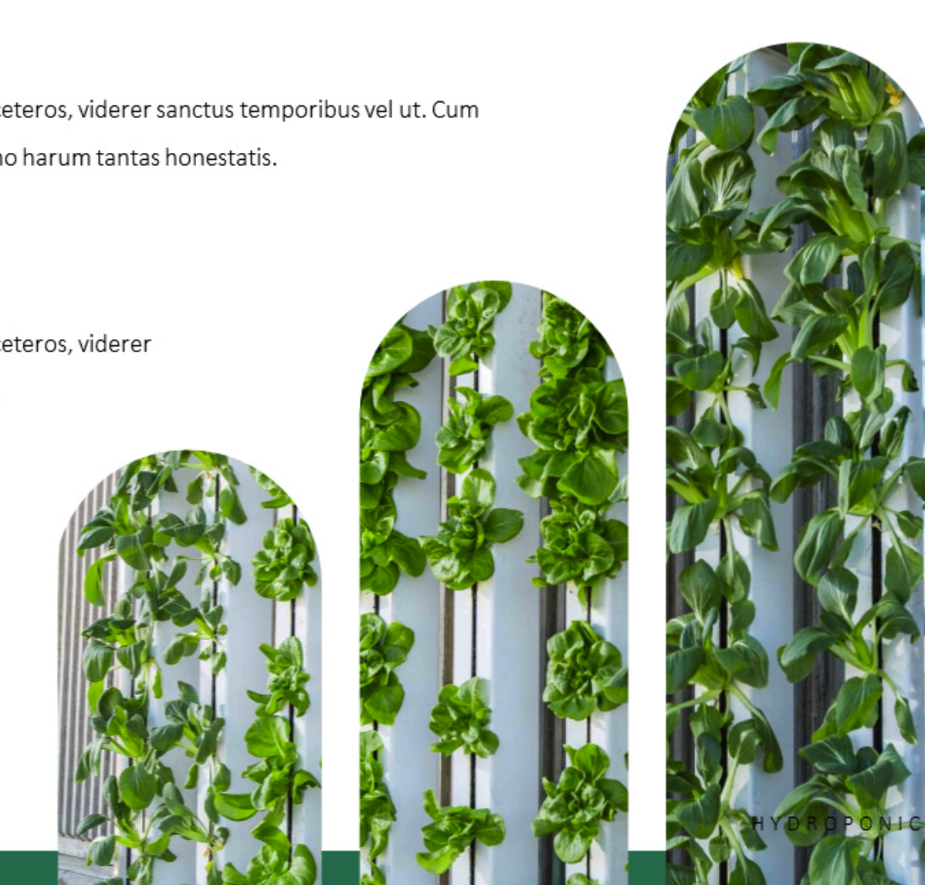
Break-Even Analysis
Key milestones in achieving profitability:
₹30 Lakhs
₹11,786
Monthly Fixed Costs
Unit Contribution Margin
Per HydroPod Basic
255
₹63.3 Lakhs
Monthly Break-Even Sales Volume
Break-Even Revenue
Break-Even Scenario Analysis
Monthly
Conservative
Base Case
Optimistic
220 units/month → Break-even in Month 22
255 units/month → Break-even in Month 18
290 units/month → Break-even in Month 15
Path to Profitability
Month 1-12
Month 19+
Year 3
Negative cash flow (₹180-220 Lakhs cumulative)
Positive cash flow
₹2,202.4 Lakhs net profit
1
2
3
4
5
Month 13-18
Year 2
Break-even achieved
₹754.4 Lakhs net profit

Slide 24
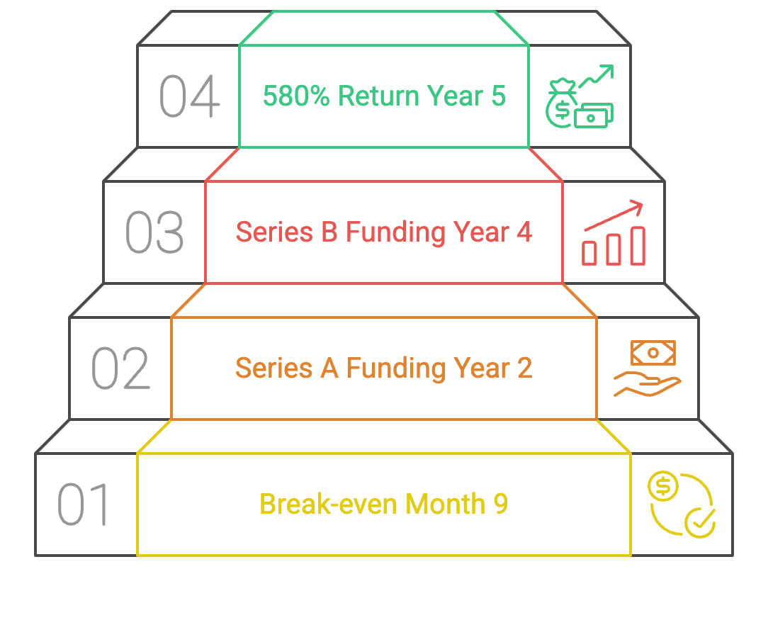
Investment Structure
Seed Round Allocation (₹622.5L):
Product Development: ₹249.0L (40%)
Initial Production: ₹217.9L (35%)
Team & Operations: ₹93.4L (15%)
Marketing & Sales: ₹62.3L (10%)
Investment | Year 0 | Year 1 | Year 2 | Year 3 | Year 4 | Year 5
Capital | 622.5 | - | 2,905.0 | - | 8,300.0 | - | Seed, Series A, Series B rounds
Working Capital | 160.0 | 220.0 | 380.0 | 560.0 | 820.0 | 1,240.0 | Inventory & operational needs
Cumulative Investment | 782.5 | 1,002.5 | 4,287.5 | 4,847.5 | 13,967.5 | 15,207.5 | Total funding required
Revenue | - | 1,269.9 | 4,274.5 | 8,565.6 | 15,454.6 | 25,979.0 | Growing revenue streams
Net Profit | (622.5) | (82.0) | 754.4 | 2,202.4 | 5,010.6 | 9,917.5 | Profitable from Year 2
Cumulative Profit | (622.5) | (704.5) | 49.9 | 2,252.3 | 7,262.9 | 17,180.4 | Break-even in Year 2
ROI (Annual) | - | - | 18% | 51% | 36% | 65% | Strong returns after Y2
Valuation Multiple | - | 3.5x | 5.8x | 7.2x | 9.1x | 12.4x | Based on revenue growth
Company Valuation | 1,200.0 | 4,445.0 | 24,792.0 | 61,672.0 | 140,637.0 | 322,140.0 | ₹ Lakhs
INVESTMENT MILESTONE
18

Slide 25
Revenue Structure
Hardware Sales: Base units, expansion modules, accessories (65%)
Subscription Revenue: Seed pods, premium app features (25%)
B2B Solutions: Restaurant/educational partnerships (10%)
Revenue Stream | Year 1 | Year 2 | Year 3 | Year 4 | Year 5
Hardware Sales
Base Units | 788.5 | 2,324.0 | 4,316.0 | 7,387.0 | 11,786.0
Expansion Modules | 149.4 | 597.6 | 1,245.0 | 2,324.0 | 3,818.0
Accessories | 58.1 | 232.4 | 431.6 | 788.5 | 1,411.0
Hardware Subtotal | 996.0 | 3,154.0 | 5,992.6 | 10,499.5 | 17,015.0
Subscription Revenue
SeedPod Subscriptions | 240.7 | 913.0 | 1,975.4 | 3,527.5 | 5,976.0
Premium App Features | 33.2 | 124.5 | 265.6 | 539.5 | 913.0
Subscription Subtotal | 273.9 | 1,037.5 | 2,241.0 | 4,067.0 | 6,889.0
Other Revenue
B2B Solutions | - | 58.1 | 232.4 | 622.5 | 1,535.5
Partnerships & Licensing | - | 24.9 | 99.6 | 265.6 | 539.5
Other Subtotal | - | 83.0 | 332.0 | 888.1 | 2,075.0
Total Revenue | 1,269.9 | 4,274.5 | 8,565.6 | 15,454.6 | 25,979.0
Gross Profit | 688.9 | 2,498.3 | 5,220.7 | 9,603.1 | 16,600.0
Net Profit | (82.0) | 754.4 | 2,202.4 | 5,010.6 | 9,917.5
Key Revenue Metrics
Metric | Year 1 | Year 3 | Year 5
Active Users | 4,200 | 31,000 | 82,000
Annual Revenue Per User | ₹30,212 | ₹27,639 | ₹31,706
Subscription Attach Rate | 78% | 86% | 90%
Overall Gross Margin | 54% | 61% | 64%
Net Margin | -6.5% | 25.7% | 38.2%

Slide 26
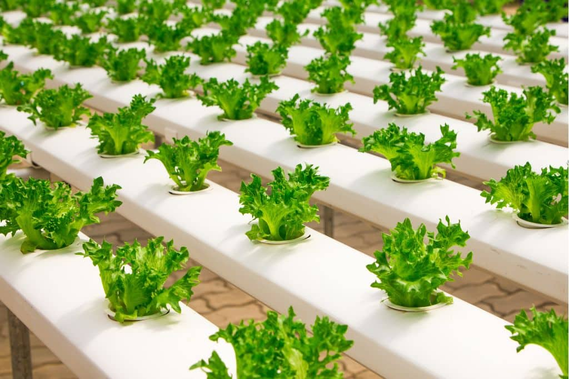
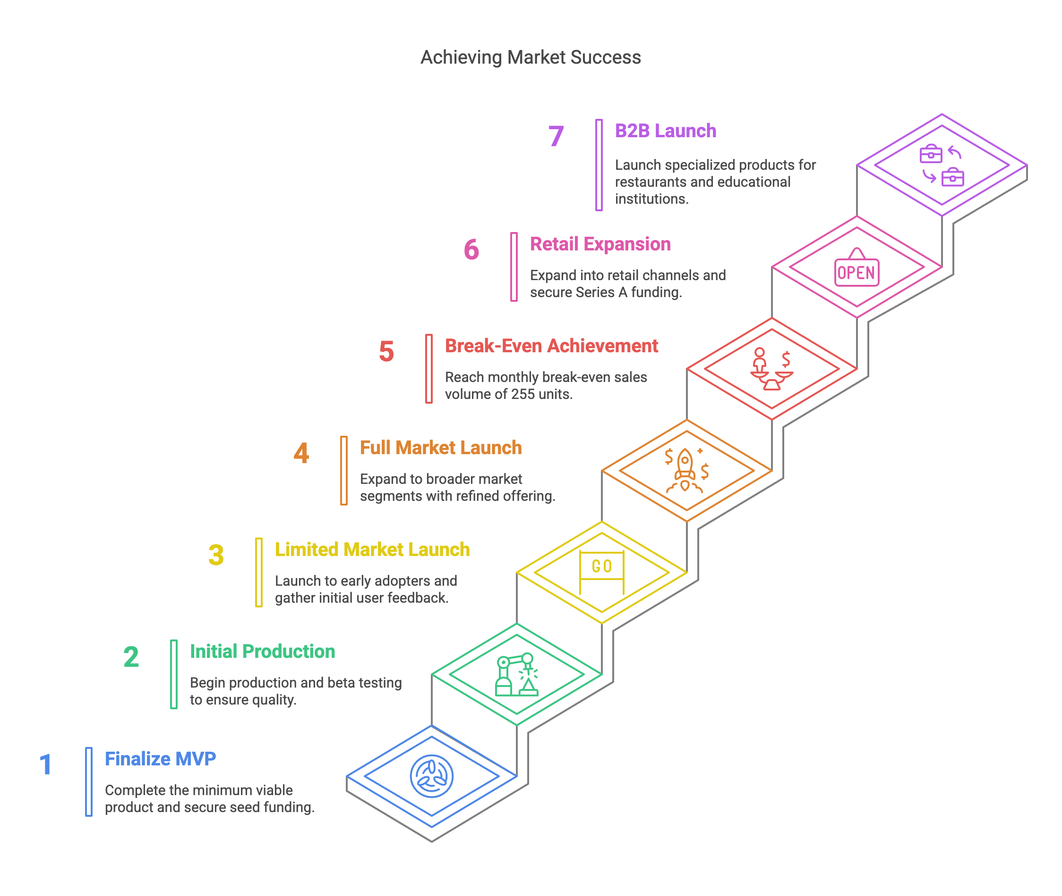
Key Milestones
2027
Q4 2026
Q3-Q4 2026
Q2-Q3 2026
Q1 2026
Q3-Q4 2025
Q1-Q2 2025

Slide 27



The Ask: Partnering for Growth
₹622.5 Lakhs Seed
1
To scale production,and grow the team with a clear path to break-even within 1.5 year
Expertise
2
Strategic guidance in distribution and supply chain management.
Connections
3
Access to premium retail partners, agricultural networks, and
sustainability ecosystems in India.
We're seeking ₹622.5 Lakhs seed investment to scale HydroPod's innovative hydroponics technology across India. Our projections show break-even in 18 months, profitability in Year 2, and 580% ROI by Year 5, powered by our dual hardware-subscription model with 72-85% margins. Beyond capital, we need strategic expertise in distribution and agriculture networks to revolutionize urban farming in India, where we're addressing a ₹6,250 crore market opportunity with our proprietary AI-driven system.

Slide 28
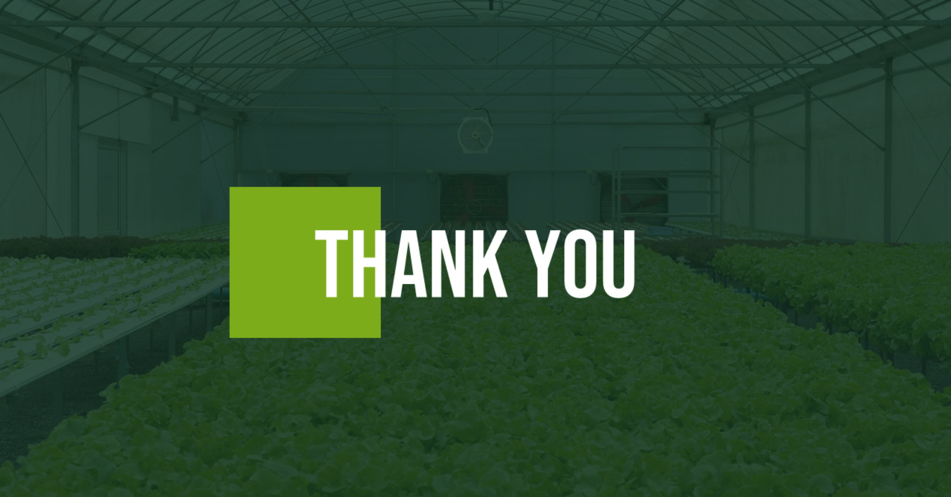

Slide 29
SALES CHANNEL​ | PRODUCTION​ | KEY STRATEGY COMPONENTS​
Online platform, ​ delivering products​ PAN India ​ directly to customers doorsteps.They have a strong digital presence with over 25k followers on their ​ Instagram page.​ ​ | Production began in a 200 sq feet kitchen with an initial investment of Rs 5000. They plan to scale operations by introducing nitrogen flushing to increase the shelf life of their products to 2.5 months.​ ​ | ​

Slide 30






Building Relationships That Last
Customers
Pride in growing own food, desire for sustainability.
Employees
Mission alignment, innovation opportunity, growth potential.
The Team
Suppliers
Long-term relationship security, recognition for quality.
Founding Team
Key Hires
Investors
Experienced professionals with expertise in business, technology, and hydroponics.
Talented individuals in engineering, operations, and marketing drive execution.
Growth potential, impact investment, innovation participation.

Slide 31
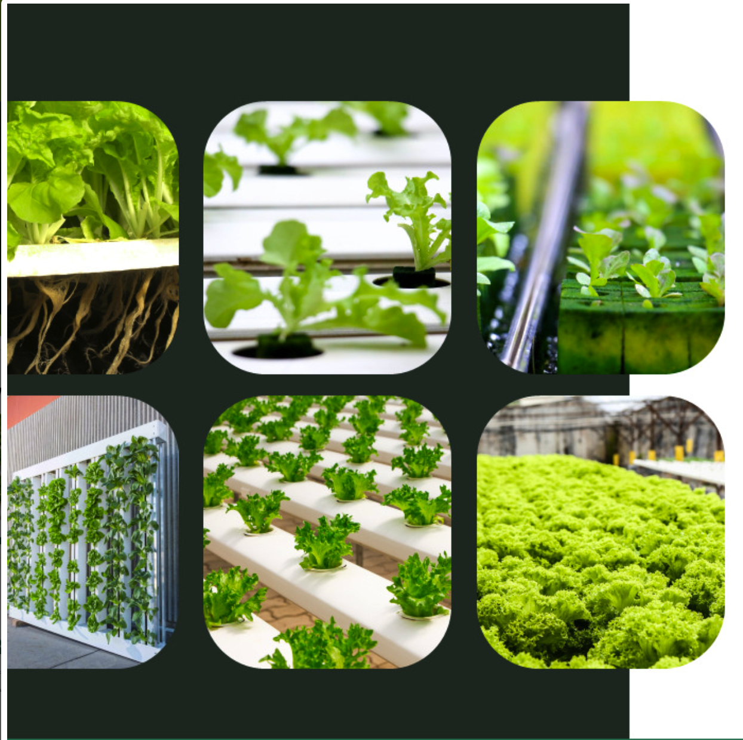
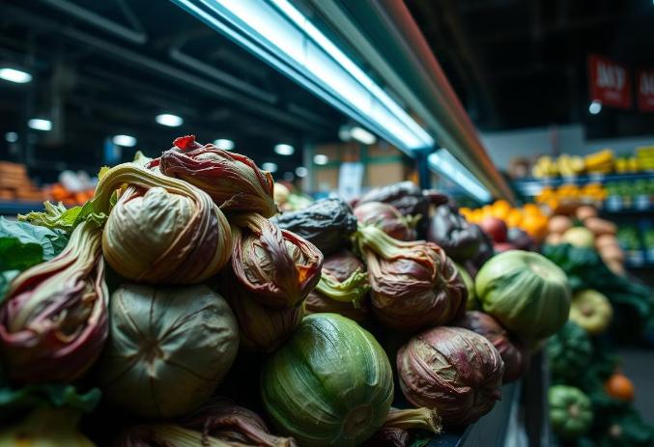
The Problem: Disconnection from Fresh Food
Declining Nutritional Value
Modern agriculture prioritizes yield over nutrient density, resulting in produce with diminished vitamin and mineral content.
Environmental Impact
Traditional farming practices contribute to soil degradation, water pollution, and greenhouse gas emissions, posing significant environmental challenges.
Food Miles and Waste
Long supply chains lead to increased transportation costs, food spoilage, and carbon emissions, reducing the freshness and sustainability of produce.
Limited Access
Urban dwellers and those in food deserts face challenges in accessing fresh, affordable, and nutritious produce, impacting their health and well-being.
These issues highlight a growing need for innovative solutions that prioritize nutrition, sustainability, and accessibility in food production. HydroPod addresses these problems head-on, offering a transformative approach to home agriculture.

Slide 32
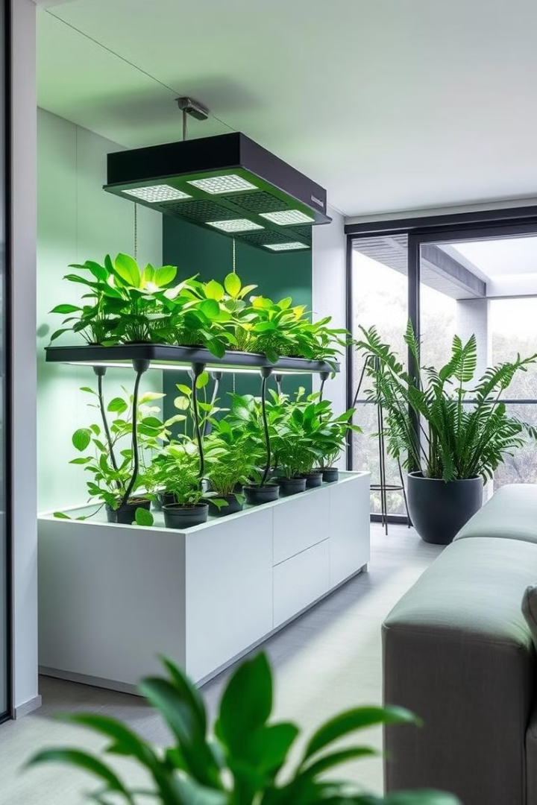
Mission & Vision
Welcome to HydroPod, where we're not just growing plants, we're cultivating a future of sustainable, accessible, and personalized agriculture. We are driven by the vision to transform how people connect with their food, by bringing the benefits of hydroponics into every home. Our mission is to empower individuals to grow fresh, healthy produce year-round, regardless of their location or experience. We envision a world where everyone has access to nutritious, locally-sourced food, contributing to a healthier planet.

Slide 33



HydroPod: The Smart Solution
Fresh Produce
Water Efficiency
Space Saving
Year-round access to nutritious, home-grown fruits and vegetables.
Hydroponic systems use up to 90% less water than traditional agriculture.
Vertical design maximizes growing capacity in minimal space.
HydroPod is the smart modular home hydroponic kit that empowers individuals to grow fresh, healthy produce right in their homes. Our competitive advantage lies in our patented nutrient delivery system and user-friendly mobile app, which provides real-time monitoring and automated adjustments for optimal plant growth. This makes HydroPod accessible to both beginners and experienced gardeners alike.

Slide 34
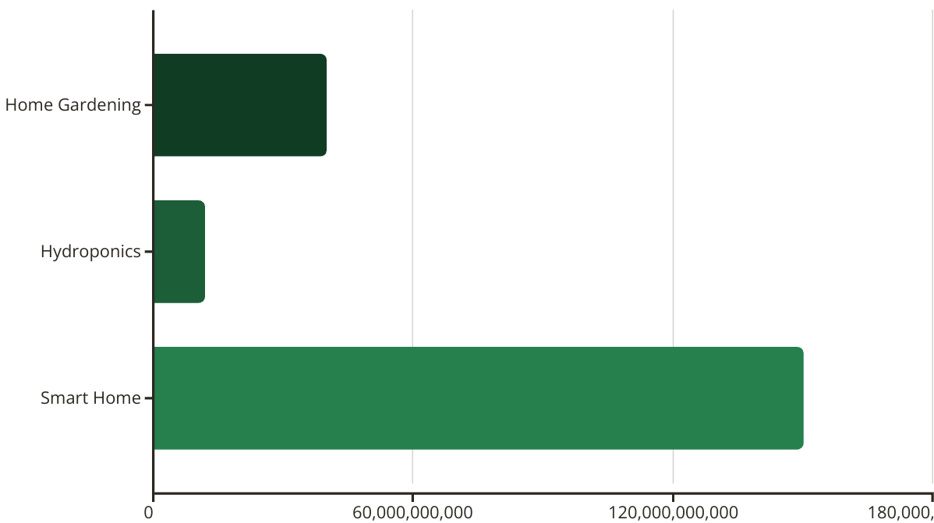
Market Analysis: A Blooming Opportunity
The global home gardening market is a multi-billion dollar industry, with hydroponics and smart home technology experiencing exponential growth. Our target market includes health-conscious consumers, urban dwellers, and tech-savvy individuals seeking sustainable food solutions. Key competitors include traditional gardening suppliers and emerging hydroponic system providers. HydroPod differentiates itself through its innovative technology, modular design, and comprehensive user support.

Slide 35
Business Model: Cultivating Revenue
Kit Sales
Subscription
Direct sales of HydroPod kits through our website and retail partnerships.
Recurring revenue from nutrient refills and system upgrades.
App
Service
Premium features via in-app purchases.
Installation and maintenance packages for a premium experience.
Our revenue model is based on a combination of direct sales, subscription services, and premium support offerings. Our pricing strategy is competitive, with tiered options to cater to a wide range of customers. Our scaling plans include expanding our product line, establishing strategic partnerships with retailers, and entering new geographic markets.

Slide 36
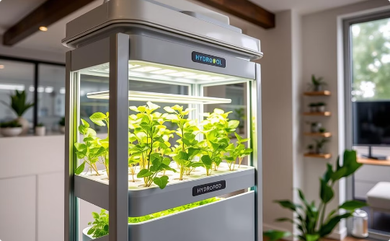
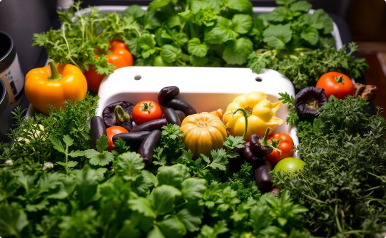
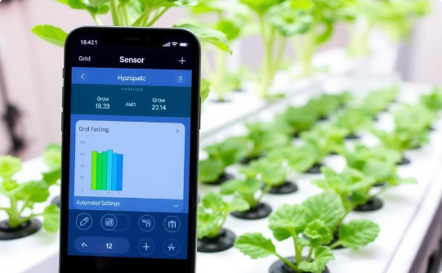
Product Demo: See HydroPod in Action
Automated Growing
Home Agriculture
Mobile Control
Sensors track nutrients, pH, humidity, and water level. The app gives you total control.
The system is easy to set up and maintain, making it perfect for beginners.
Real-time monitoring and adjustments ensure optimal plant health and growth.
Don't take our word for it. "HydroPod has transformed my kitchen into a thriving garden. I'm amazed at how easy it is to grow my own organic vegetables," says Sarah J, HydroPod user.

Slide 37
Traction: Growing Momentum
500+
20%
4.8/5
Happy Customers
Month Growth
User Ratings
Proven product market fit with positive customer feedback.
Rapidly growing user base with increasing demand.
High satisfaction rate on major review platforms.
Our early achievements demonstrate the strong potential of HydroPod. User feedback highlights the ease of use, convenience, and satisfaction in growing their own fresh produce. These positive reviews, combined with our impressive growth metrics, solidify our confidence in HydroPod's long-term success.

Slide 38

Market Strategy: Seeding Success
Digital Marketing
Targeted online campaigns to reach health-conscious consumers.
Retail Partnerships
Collaborations with home improvement stores and garden centers.
Influencer Marketing
Engaging with relevant influencers to promote HydroPod.
Community Engagement
Building a loyal community through workshops and online forums.
Our go-to-market strategy combines digital marketing, retail partnerships, and community engagement to maximize brand awareness and drive sales. We have established key partnerships with local nurseries and sustainable living organizations, enhancing our reach and credibility. These collaborations will enable us to tap into established networks and accelerate market penetration.

Slide 39
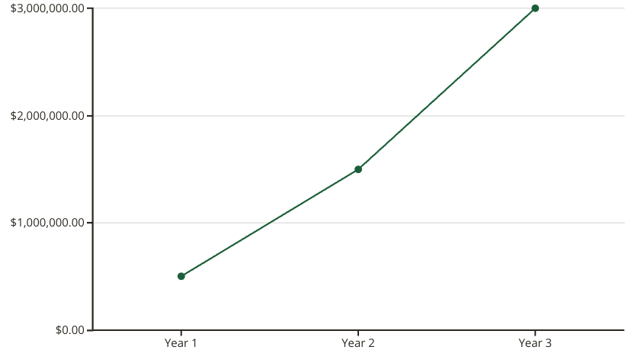
Financial Projections: A Bountiful Harvest
Our financial projections demonstrate a strong growth trajectory, with significant revenue increases expected over the next three years. Our break-even analysis indicates that we will achieve profitability within the second year of operation. These projections are based on conservative estimates and take into account market trends, competitive pressures, and our strategic growth initiatives. We are confident in our ability to deliver attractive returns to our investors.

